Slide 1
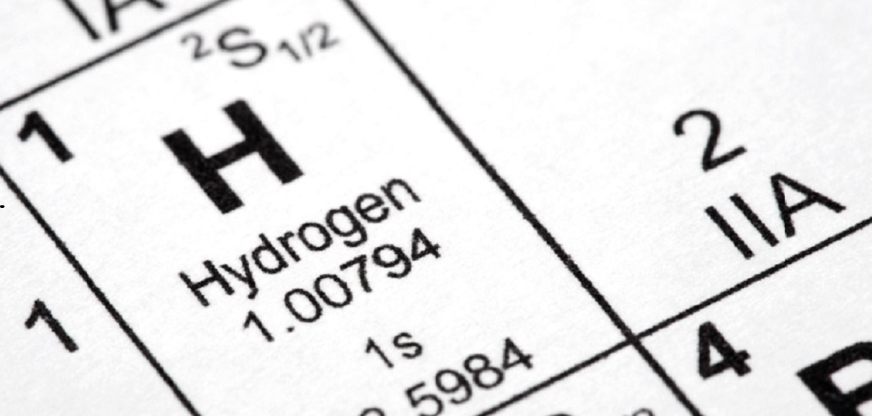
The role of hydrogen in a net zero future
Mark Crowther

Slide 2

The David Gunn
Memorial Lecture
The role of hydrogen in a net zero future
The solution for a real problem
Mark Crowther
Technical Director – Kiwa Ltd

Slide 3
Assertions
The world is not short of potential renewable energy
6,200 km2 of Sahara desert would produce all UK final energy needs (1/2 of an Australia sheep farm!)
The world does require an energy vector
Reliable, modestly priced to move this energy from point of production/capture and transfer to consumer when required
Historically, storage has enabled transparent markets
The separation of production from use improves the efficiency of both
Ideally the vector should not be poisonous, or of short life
Ideally no greenhouse gas emissions at point of use

Slide 4


Slide 5

Sahara
Area for all UK energy end use at 300kWh/m2/yr
(Google maps)

Slide 6
Options for energy vectors include:
Electricity
Hot water / Steam
Methane with a biologically derived carbon atom
Ammonia etc
Hydrogen - liquid & gas
Today I will major on gaseous hydrogen - mostly at low pressure
The origins of this paper lie in a presentation by myself to DECC 29th Feb 2012.
Until this date it had been presumed de-carbonisation required an All Electric World.

Slide 7
Hydrogen
Hydrogen is not a solution looking for a problem, BUT a solution to very real and complex issues, the principal one being:
UK inter-seasonal variation in energy demand

Slide 8
UK inter-seasonal variation in energy demand

Slide 9
Hypothesis of this presentation
Hydrogen to replace Natural gas in the existing plastic low pressure distribution systems (some ~2barg, but principally 25-70millibarg)
As required, these would be inter-connected with a new high pressure national/international hydrogen transmission system at 85bar

Slide 10


Hydrogen: its properties
Hydrogen about 80% of the diameter of methane molecule
 | MW | CV MJ/kg | Density @ 288K | Wobbe Index (15/15)
Hydrogen | 2.016 | 141.8 | 0.0852 | 45.8
Methane | 16.04 | 55.5 | 0.678 | 50.6
Propane | 44.1 | 50.35 | 1.86 | 76
CO | 28.1 | 10 | 1.18 | 12.1
Air | 28.9 |  | 1.22 | 0
Flammable, colourless, biologically inert gas burns to water
Very light gas, density ~0.08kg/m3 (about 1/8 methane, ~0.67 kg/m3 )
Low calorific value of about 11,930kJ/m3 (about 1/3 methane, ~37,600kJ/m3)
Stoichiometric mixture 29% (Methane 10%)
Flammable limits 4-74% (Methane 4-15%)

Slide 11
Other issues
Town’s gas was about 50%v/v hydrogen
    Still used in parts of the world; Town’s gas also contains high concentrations of carbon monoxide, a poisonous gas CO is also produced from poor Natural gas combustion.
    Town’s gas had a good safety record with regards to fire & explosion
Hydrogen is buoyant in air
    Hydrogen flames ascend rapidly and cause less radiation damage than hydrocarbon fires
Objections due to experience of the old airships
    Cause of the Hindenburg disaster unclear, probably an atmospheric-related static spark. 2/3 of the passengers and crew survived. Many deaths were the result of falls or burning diesel fuel. It was an aviation accident.

Slide 12
Other issues
    The UK gas industry is very safe; about 13 injuries in 2018 compared to 18 from dishwashers alone. A high percentage of these injuries are from third party and DIY damage.
    No reason why hydrogen should not be equally safe.
    Distributed hydrogen will be odorised with the same odorant and at the same concentration as Natural gas. The HSE will insist upon this.
    Hydrogen is essentially an energy vector (similar to electricity or steam).
    Rather than a source, it has to be created (often from water) using another form of energy.

Slide 13
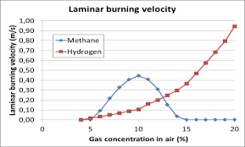
Hydrogen: safety
Stoichiometric hydrogen (~29%v/v) and methane (~10%v/v) burn to create
similar temperatures (~2100°C) and pressures (~8bara)
To be avoided
But the burning velocity is different,
hydrogen (at high concentrations)
burns much faster; levels above
~18%v/v should be avoided
Difficult to cause meaningful explosion below ~8.5%
Ref Mozees.No
In practice this means that for small and medium leaks hydrogen is safer/comparable to methane.
Large leaks could be more dangerous but this can be solved with excess flow valves that interrupt the flow of hydrogen entirely in the event of a punctured/ruptured pipe
Hydrogen appliances will have to be rigorously tested (BSI PAS4444).

Slide 14
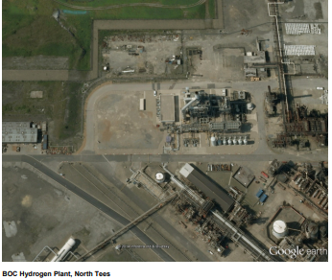


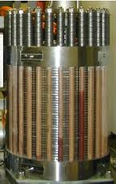


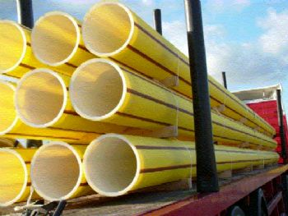




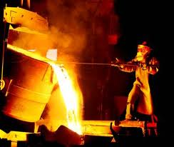
SMR
CO2
Carbon Capture
Electrolyser
H2
Existing PE Network
Hydrogen Storage
Rutland Pipe
Renewable Energy
Domestic
Commercial
Transport
Industry

Slide 15
Overview of concept
The plan offered here is to convert local gas networks to hydrogen on a piecemeal basis in order to provide zero carbon energy supplies for:
Current users of Natural gas including industry, commerce and the domestic sectors
Transport, via the installation of hydrogen dispensing pumps at filling station forecourts within the zone
These could be based around any of the following recent studies:
        Leeds H21 - First GDNO city-wide scheme by NGN. Main contractor Kiwa Gastec
        North of England. Teesside, Leeds, Manchester and Liverpool (the most recent)
        HyNet around Merseyside by Cadent
        Project Cavendish. London. Hydrogen south of the Thames

Slide 16
Repurposes existing infrastructure
Conceptually simple. Permitted by 1986 Gas Act, where hydrogen is a specifically identified gas
No substantial change to the infrastructure is required either in the street, or in the home, although appliances will need to be converted/replaced
Transition can be locally based and locally decided
Meets localism criteria
No impact on international carriage of Natural gas through the UK
No impact on power generation or other very large gas users
Gas infrastructure is inherently low cost and hydrogen is a well proven and low cost technology

Slide 17
Low hassle factor for users
Conversion to hydrogen should take <36hrs ie less than 2 working days, be free
at time of conversion (ref Gas ‘86) and should be managed by the GDNO.
In contrast:
External/internal insulation
    Redecoration & aesthetic changes
    Large capital expenditure (£10k)
Air Source Heat Pump
    Giving up combi boiler
    Installing large DHW tank
    Loss of space in garden
    Large capital expenditure (£10k)
    Good chance of higher fuel bills
    No option of morning or evening heating
    Larger radiators
    Complex discussions with tradesmen

Slide 18
Why hydrogen?
Produce
Transport
Store
Distribute
Use
Low cost to:

Slide 19
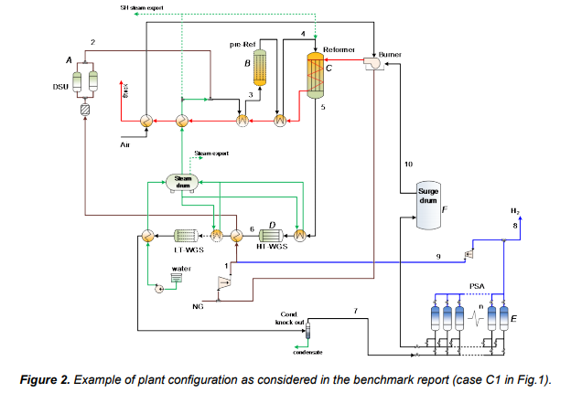

Range of reforming options
Manufacture hydrogen by taking the carbon atom out of methane. CH₄ + 2H₂O 4H₂ + CO₂
Steam methane reforming (SMR) plus CCS
Certainly lowest cost hydrogen but absolutely requires
CCS at a large scale

Slide 20
By electrolysis
By electrolysis from renewable sources – an electrolyser may typically operate at an efficiency of around 80% (including ancillary power consumption)
Inherently produces low carbon electricity but only when the wind blows or sun shines
There is unlikely to be sufficient genuinely ‘surplus’ renewable energy to be viable in the foreseeable future. Dedicated wind/solar farms will be necessary

Slide 21
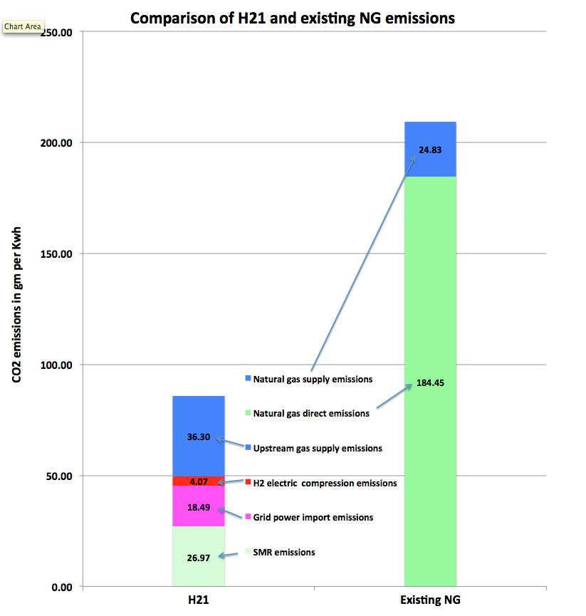
Carbon emissions - the rationale behind the conversion
Components of Scope 3 carbon footprint of Natural gas, SMR, hydrogen and wind turbine hydrogen
~15
Wind based
electrolysis

Slide 22
Current range of bulk hydrogen costs (ex works)
 |  | Reformer ATR | SMR | Electrolysis
Feedstock | £/kW | £0.02 | £0.02 | £0.04
Efficiency |  | 79.90% | 79.50% | 70.90%
Capital | £/kW | £631 | £721 | £906
Life | Years | 25 | 25 | 25
%ROI |  | 6% | 6% | 6%
Annual Production |  | 8500 | 8500 | 4029
Cost of OPEX | £/kWh | £0.00 | £0.00 | £0.01
Cost of CAPEX | £/kWh | £0.01 | £0.01 | £0.02
Cost of fuel | £/kWh | £0.02 | £0.02 | £0.05
Cost of CO2 disposal | £/tonne | 20 | 20 | 0
Cost of CO2 disposal | £/kWh | £0.00 | £0.00
Total | £/kWh | £0.04 | £0.04 | £0.08
Bid price Oct 2019
Atmospheric electrolyser
£kW_{H2}
Summer 2019
Rounded to £0.00

Slide 23
Why hydrogen?
Produce
Transport
Store
Distribute
Use
Low cost to:

Slide 24
Hydrogen transport
Low pressure H₂ - broadly similar transport properties to Natural gas
At 85bar_{g} it has a lower compressibility factor and is more difficult to compress so a new hydrogen transmission system will need slightly larger pipes and more complex compressor stations, but the cost is still very low
Natural gas can be brought to UK for <~1p/kWh
 | MW | Dist km | Project cost | £/MW km | Ref GaC from public data | Ratio to av: gas
Brit Ned | 1000 | 240 | £540m | £2250 | Sub-sea HVDC | 1:23
Scotland wind | 2700 | 220 | £350m | £589 | Beauly-Denny, Scotland | 1:6
S Wales NTS | 24000 | 316 | £700m | £92 | Milford Haven to Stroud
Nord Stream | 68000 | 1222 | £8800m | £106 | Vyborg , Greifswold
Carlisle to Sellafield to Heysham HV | 3400 | 190 | £2800m | £4325 | Planning application through National Park | 1:47
Spittal to Blackhillock | 190 | 320 | £970m | £2526 | As built – mixed line | 1:26

Slide 25
Why hydrogen?
Produce
Transport
Store
Distribute
Use
Low cost to:

Slide 26
Hydrogen storage
Compressed underground hydrogen storage is entirely proven and new sites are under construction today eg PRAXAIR in Texas
Hydrogen caverns are operated in
Teesside, UK by Sabic Petrochemicals (3 X 70,000 m³)
Clemens Dome, Lake Jackson, Texas, USA by ConocoPhillips (580,000 m³)
Moss Bluff salt dome, Liberty County, Texas, USA by Praxair (566,000 m³ – maximum permitted capacity)
This last facility has the capacity of about 4mboe or 2.5% of UK annual energy demand or 50 Cruachan pumped storage stations

Slide 27
Indicative costs of storage
The surest route to reducing energy production cost is to increase operating hours of the producer and/or not restrict output, hence the value of storage ie to disconnect (in time) production from use.
Storage capacity | GWh | 8052
CAPEX |  | £1,991,000,000
Depreciation | years | 40
ROI | % | 6
Annual charge |  | £169,235,000
OPEX |  | £63,000,000
Total costs |  | £232,235,000
Cost storage /kWh |  | £0.029
Federal Energy Regulatory Commission

Slide 28
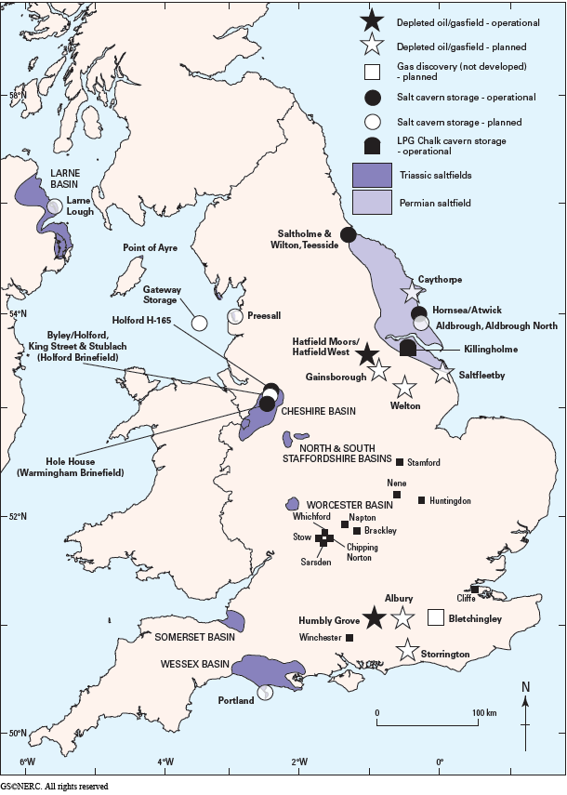
By uncoupling supply and demand a free market can exist in both
UK Annual energy (final) | 159,000,000 | toe
kWh/toe | 11,630
UK annual TWh | 1,849
91days average use kWh (Renewable) | 461
GCV Hydrogen | 3.36 | kWh/m³
Equivalent volume of H2 at STP | 1.37E+11 | m³
At 85barg | 1,614,489,578 | m³
Edge of cube | 1,164.87 | m
HyStorPor - Hydrogen Storage in Porous Media
Lead Research Organisation: University of Edinburgh (School of Geosciences)
Looking for suitable porous media in the Scottish central belt and elsewhere

Slide 29
Why hydrogen?
Produce
Transport
Store
Distribute
Use
Low cost to:

Slide 30
Gas distribution
Most of the UK low pressure distribution system is now polyethylene and operates at 25 to 75 mbar
“In summary, according to the tests performed in this study, we have found strong indications that polyethylene gas pipes PE80 and PE100 can be used for transportation of hydrogen without any adverse long-term effects on antioxidants, polymer structure or the mechanical performance of the polymer pipes. The same indications have been found for both new and old pipes that has been used in the Danish Natural gas distribution network for more than than 20 years.”
Ref Detlef Stolten, Thomas Grube (Eds.):
18th World Hydrogen Energy Conference 2010 - WHEC 2010

Slide 31
Town’s gas to Natural gas conversion programme
1967 to 1977
13m homes & 40m appliances
Cost then £563m (£42/customer)
Now equivalent to £6b (based on RPI) or £14b (based upon % UK GDP) or £70b based upon on-going conversion of the Isle of Man to Natural gas from Town’s gas (above costs exclude hydrogen production)
Very competitive against the all electric world
(ref Leicester Gas Museum)

Slide 32
Why hydrogen?
Produce
Transport
Store
Distribute
Use
Low cost to:

Slide 33


Hydrogen appliances
By not taking carbon into the community we can immediately have total confidence in the true extent of carbon saving
Hydrogen versions of some appliances already exist or are relatively simple to design
Hy4Heat has placed development contracts with the following companies
Hy4Heat tenders are currently being assessed for catering equipment and commercial boilers
There must be opportunities for local power generation from low temperature fuel cells

Slide 34
Why hydrogen?
Produce
Transport
Store
Distribute
Use -
Transport
Sector
Low cost to:

Slide 35
Use in transport
28m vehicles on UK roads
About 9000 filling stations in the UK
Would equate to £9bn at £1m/station (ref California today about £1.6m/fill point including generation) Compares with £50bn for HS2 rail-line
Hydrogen vehicles available now with similar performance to existing gasoline/diesel stock
Several high volume manufacturers eg Toyota believe hydrogen will be the preferred fuel for the future of the world automotive industry
This would ensure the UK stayed in the world league in this important manufacturing sector
Connecting these filling stations up to the existing LDZ would be relatively easy
Due to the effective under-utilisation of the gas grid ~8500hrs per year the true additional transportation cost of this hydrogen should be minimal.

Slide 36
Current state of play
Transport
New zero-emission hydrogen buses are being deployed in Aberdeen, Dundee, Cologne, Wuppertal, and elsewhere
The first of 11 cars have been delivered to the Met with support from the FCHJU* grants programme and are equipped to work as both marked and unmarked vehicles
Alstom and Eversholt Rail have unveiled the design of a new hydrogen train for the UK market. The train, codenamed ‘Breeze’, will be a conversion of existing Class 321 trains, reengineering some of the UK’s most reliable rolling stock, to create a clean train for the modern age

Slide 37
Why hydrogen?
Produce
Transport
Store
Distribute
Use -
Industry
Low cost to:

Slide 38
Industrial uses of hydrogen
For many years UK manufacturing has been moving towards higher added value products. A generous supply of low cost hydrogen would greatly assist this
The existing petrochemical use of hydrogen is widespread. The addition of low carbon hydrogen as a chemical feedstock will expand the commercial possibilities, across a wide range of ‘low carbon’ goods eg low carbon copper, steel or other metals
The market for low carbon manufactured goods will grow
Those companies who wished to remain on Natural gas could be assisted to run dedicated medium pressure lines to the existing (and remaining) National Grid
SABIC Wilton have carried out a major conversion to hydrogen as have other sites on Merseyside.
Fusina Hydrogen Power Station (~12MW) , Veneto, has operated since 2010

Slide 39
Industrial uses. Power Generation
There is sudden and dramatic increase in local power generation, (often IC engines) probably driven by the difference in cost of conveyance of gas and electricity…..see previous slides
This taking of carbon into the heart of the community will be problem for future de-carbonisation
BUT supplies of decarbonised hydrogen supplying low temperature fuel cells allows very low carbon power to be generated :-
  near the substation
  In the home, office or factory.
This may be a way of driving more value out of the whole hydrogen supply process.

Slide 40
Indicative costs of retail hydrogen
A few memorable numbers :
Hydrogen (SMR) is more expensive than Natural gas but much cheaper than electricity
Price, p/kWh | H2 | Nat Gas | Electricity
Retail | 7.6 | ~4.8 | 15.8
Including conversion | 9.3 | NA | NA
Cost of Leeds H21
£ | £ 2,054,000,000
Houses | 266,000
Cost/house | £ 7,721.80
Roughly
Appliance change over | £1bn
Hydrogen supply | £1bn
Compared to
Hinckley C | £18-24bn
Sellafield wires ONLY | £2.8bn
Complies with Stern valuation of global warming. 1.5% of GDP.
Ann Gas | kWh/y | £ 6,000,000,000
H2 Leeds H21 | £/kWh | £ 0.093
Current cost NG | £/kWh | £ 0.047
Marginal cost | £/kWh | £ 0.046
Total marginal | £/yr | £ 276,000,000
GVA Leeds | £/yr | £ 18,800,000,000
Leeds H21 as % GVA |  | 1.47%
How costs are allocated between taxation, domestic and commercial/industrial users
must be essentially political

Slide 41

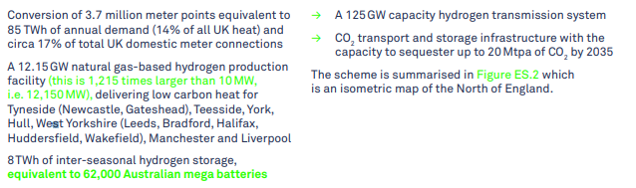

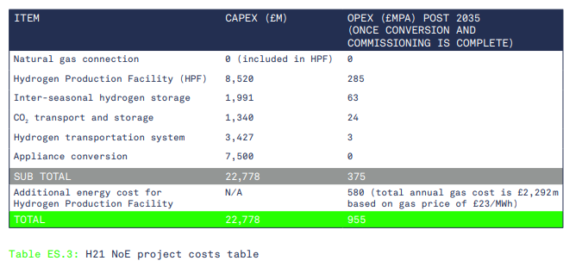
The beginnings of a greater role out
H21 North of England potential Hydrogen scheme- a serious examination of a
Norwegian link

Slide 42
Exploring the potential for London
National Grid/SGN/Cadent potential hydrogen schemes:
Project Cavendish – Hydrogen for South London
Liverpool – Manchester hydrogen cluster
Levenmouth Innovation Zone
Project Methilltoune

Slide 43
Why does hydrogen have a role in a net zero future?
Because the world is not short of low carbon energy but it is in the wrong time and place.
Because hydrogen can be transported at a fraction of the cost of electricity and can be stored geologically at low cost using no exotic elements.
Because it can be used to provide heat and power in the home, industry and transport.
Last and not least, because ordinary people really appreciate the convenience of their ‘Combi boiler’. It does what it says on the can!

Slide 44
To return and validate my original hypotheses
Hydrogen has a future because it is low cost to:
Transport - Because it is a gas of reasonable Wobbe No.
Store - Because it a compressible flammable gas of reasonable CV.
Distribute - Because it is compatible with current PE pipe and was ~50% of Town’s gas.
Use - It has excellent and proven potential in all three sectors (space heating, transport and industry) either directly or via fuel cells.
Produce - As production is never demand constrained, reducing the risk premium compared to that associated with future electric plant
And it compliments electricity as an energy vector and addresses the inevitable intermittency issues for electricity generation (especially renewable)

Slide 45
Discussion
Mark Crowther
Kiwa Ltd
This presentation was compiled specifically for delivery to a private audience.
It is strictly copyrighted to Kiwa Ltd.
All of the information is or has been derived from freely available public domain sources,
however specific permission has not been gained in all instances.

